Slide 1


TPS Image Processing Training
Transportation corridor agencies
image processing training
november, 2019
RFP no. K001063

Slide 2
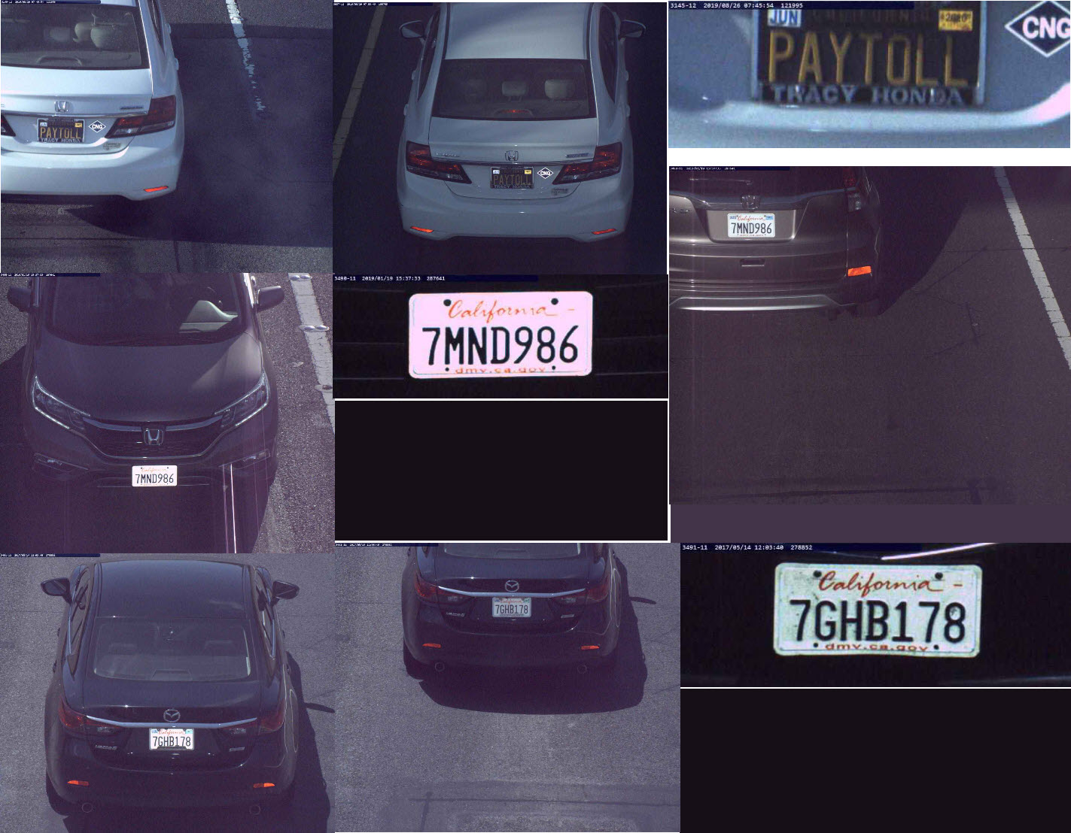

Introduction
TPS image processing
Introduction
What is image processing?
Image processing helps to identify the owner of a vehicle when no transponder read is available.
The motorist who may be an account holder could simply forget to place their transponder in the vehicle, or the transponder couldn’t be read by the AVI equipment.
Vehicle license plate images are captured at each Toll Point for all Transactions. If a valid FasTrak Transponder is not identified, the images associated with that Transaction will be available to the CSC System as an image set (Upto 24 images).
The photographs make it easier to collect the toll due.

Slide 3
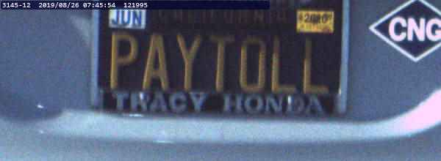
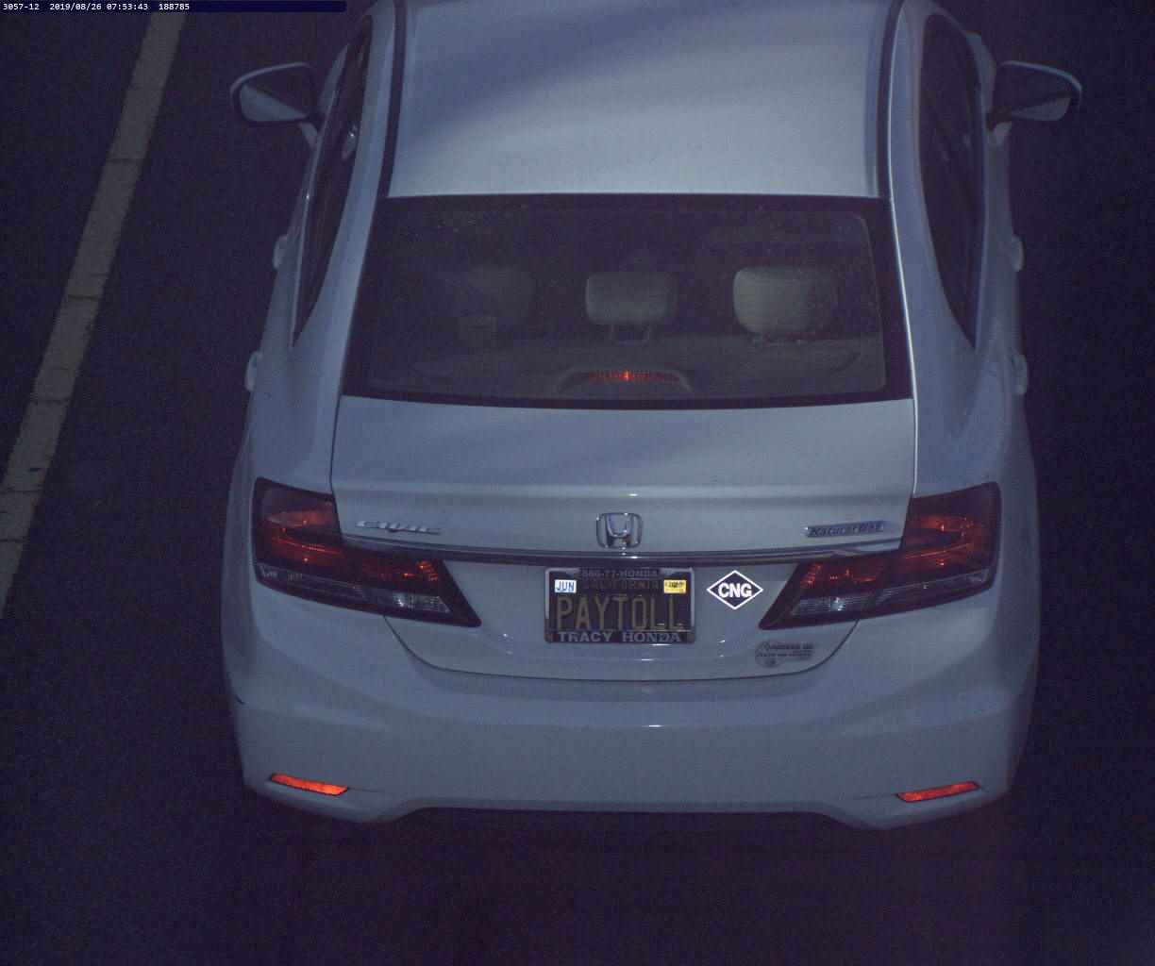
What Does It Do
TPS image processing
what does it do?
Cameras at the toll points take front and rear pictures of each vehicle passing.
If the images have a readable license plate, the Image Processing System attempts to match the plate to an account.
If the plate does not belong to an existing account, the system retrieves information about the vehicle's owner from a state registration database. For states adjoining CA (OR, NV, AZ), data is pulled directly from the database, whereas data regarding other states is retrieved using a third-party lookup service.
The Image Processing Service creates an account and tracks the transaction until payment or other disposition.

Slide 4
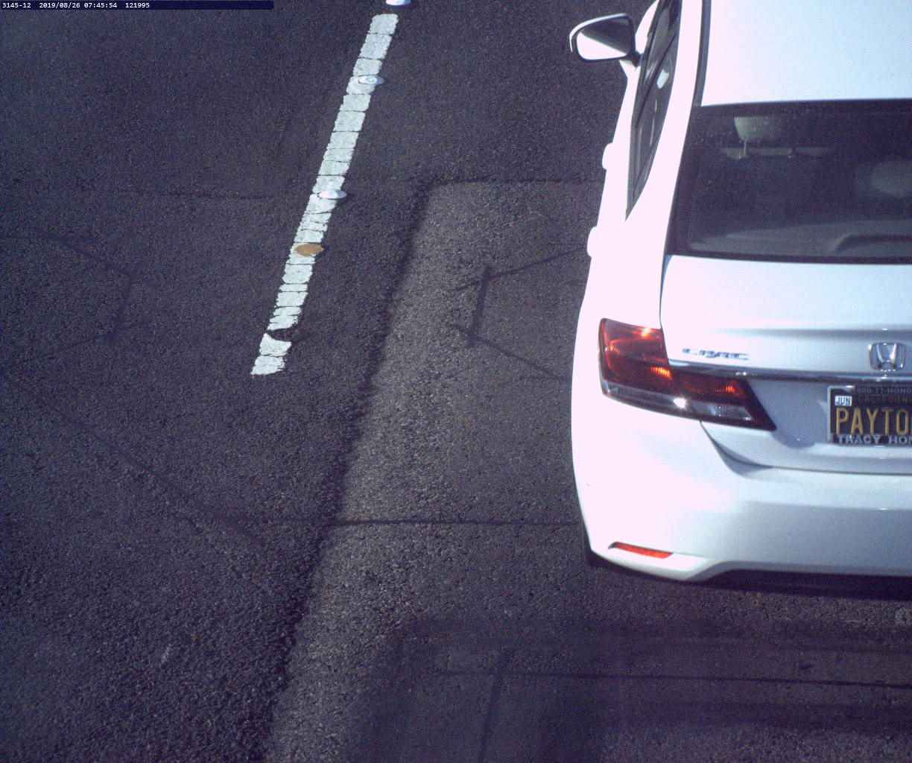

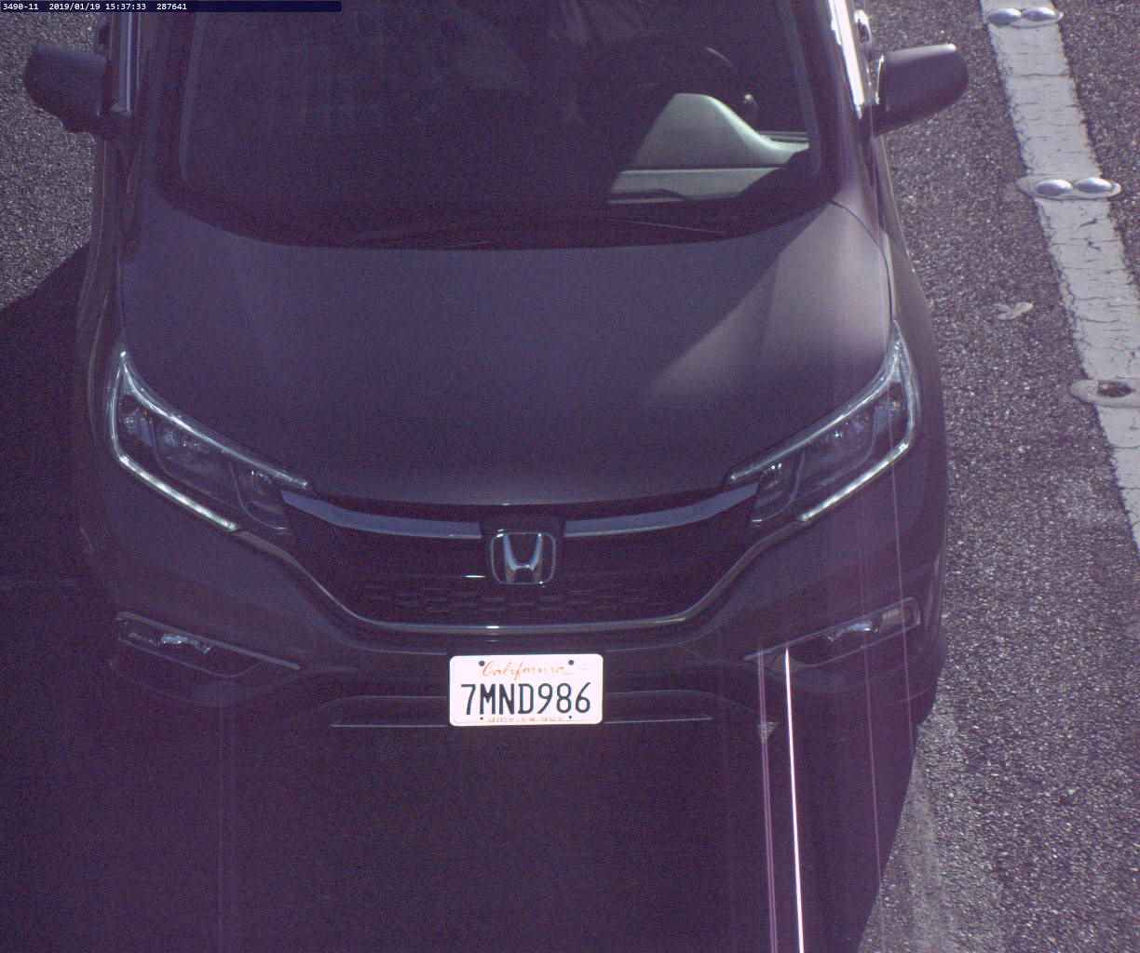
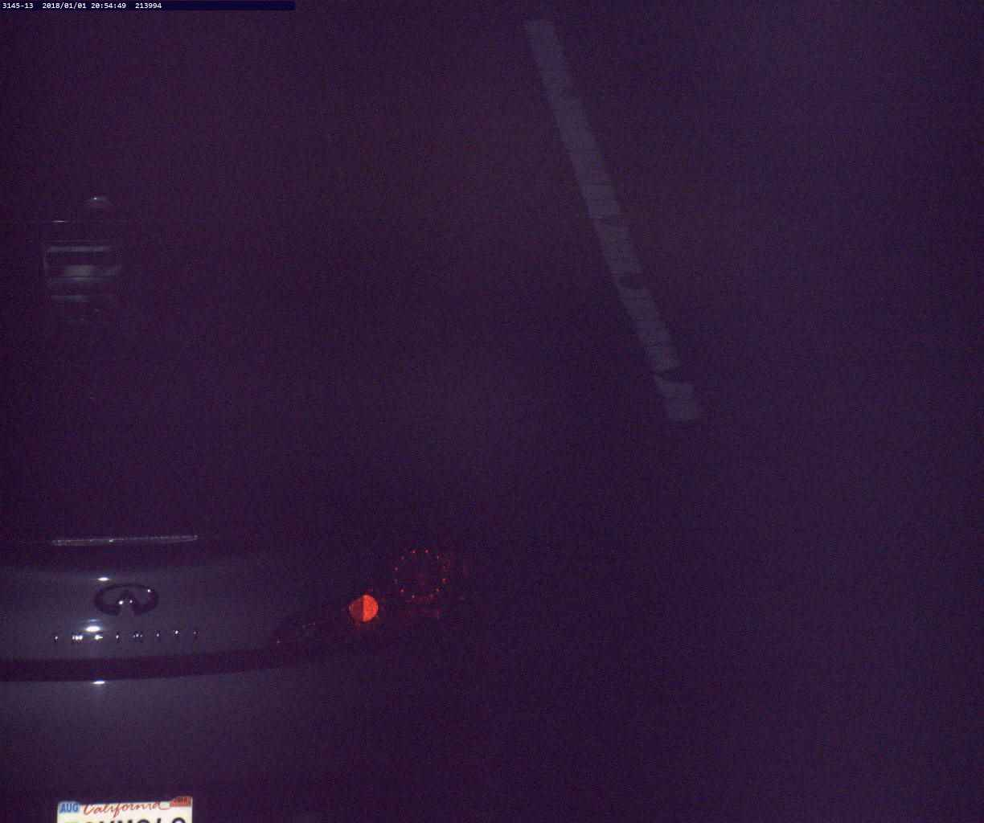
Do I Have To Look At Every Plate
TPS image processing
Do I Have to Look at Every Plate?
Short answer: NO
Only vehicles that
Do not have a transponder read.
Do not have a plate that is machine-readable with high confidence.

Slide 5


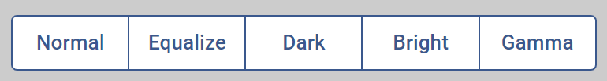
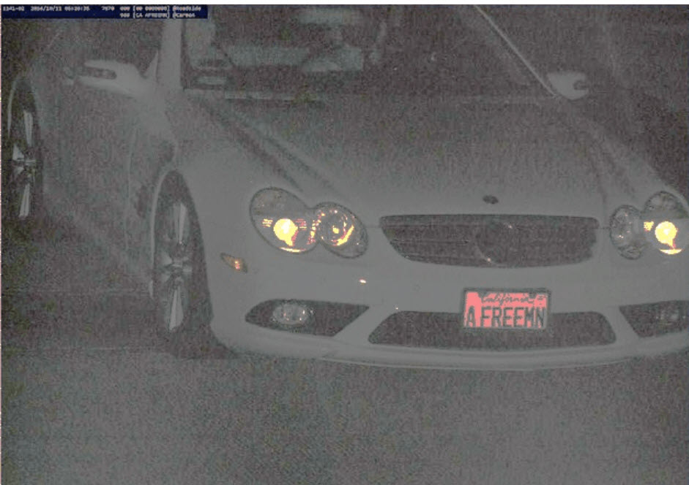
Image Enhancement
TPS image processing
Image enhancement
The Image Processing service includes image enhancement functions that help improve image quality.
If you can't read it, but someone else might be better at identifying the characters, you can return an image to the queue by pressing Enter instead of entering a plate.
If the image is incomplete, or the vehicle does not have a license plate, you can 'code off' the image .
64 – Camera Too Low
What if I can’t read it?
Equalize

Slide 6
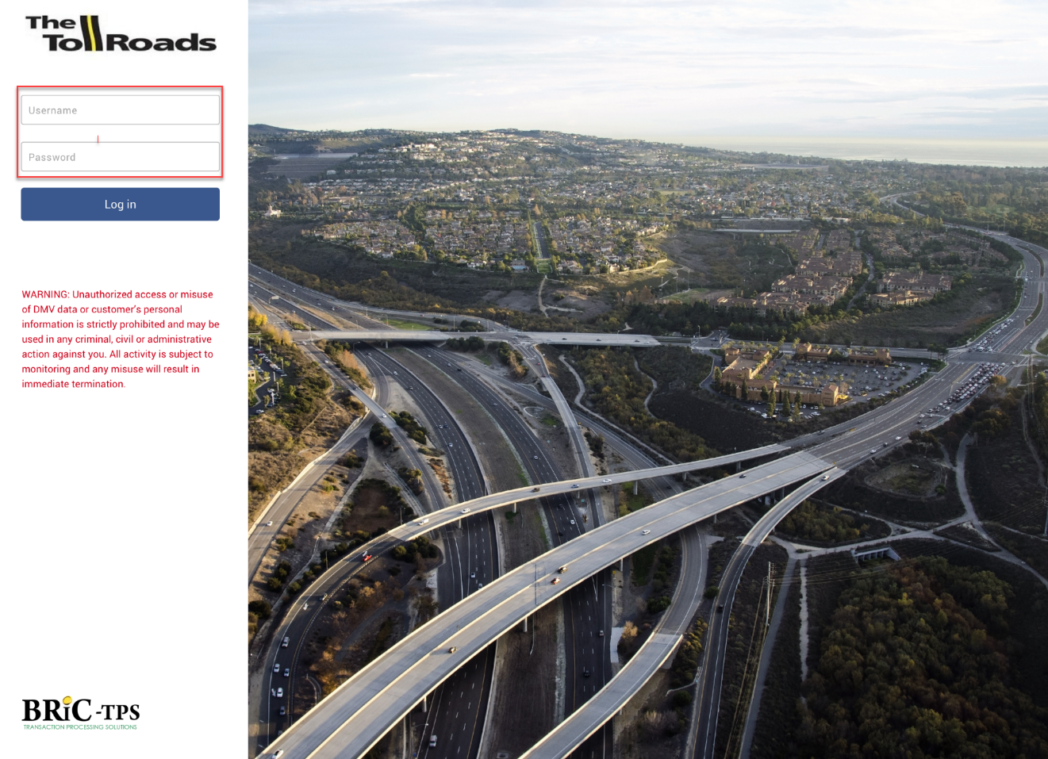
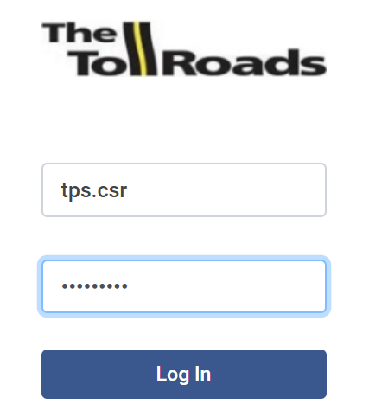
Login to the TPS system
TPS image processing
Login to the tps system
The TPS Image Processing works from the TPS System. So, the first step is to login to TPS using the username and password assigned to you.
Open a browser to the URL for the TPS application.
The login page opens with the cursor in the Username field.
Enter your username and password in their respective fields and click Log In.
A Search page appears. (next slide)

Slide 7
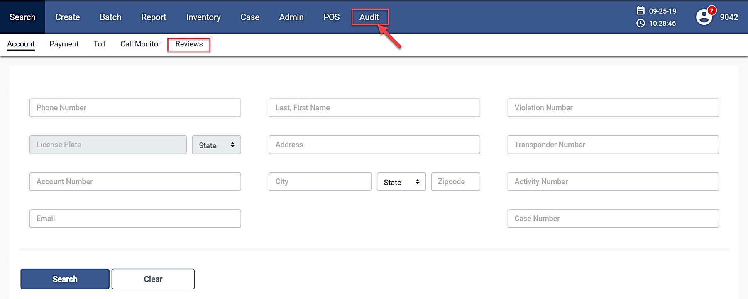
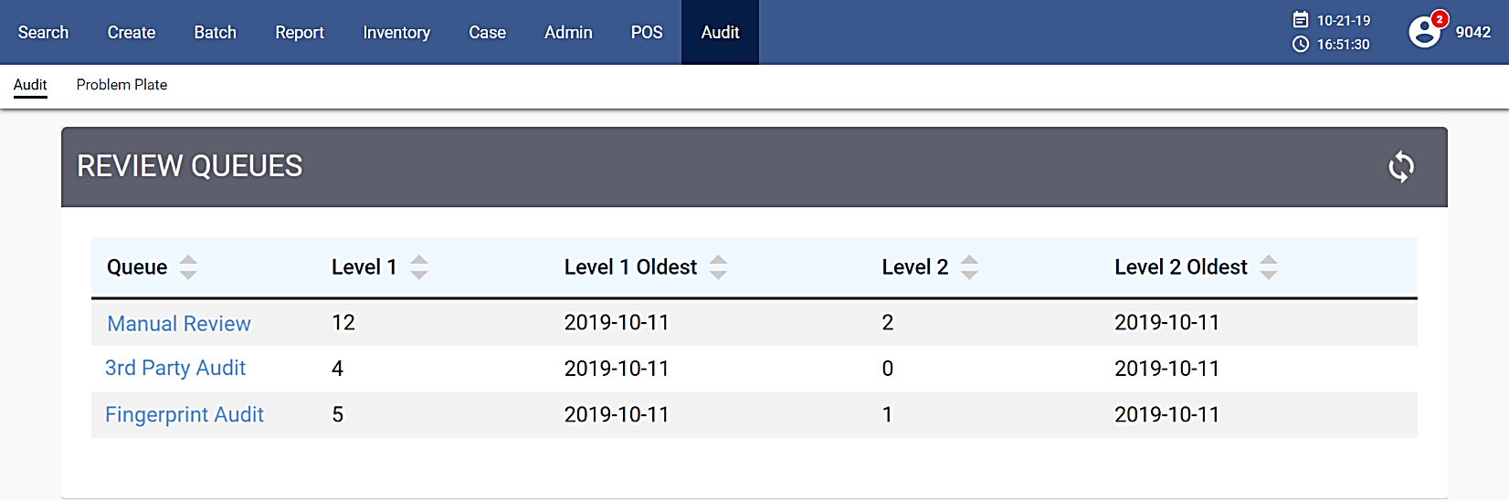
Image processing screen
TPS Image processing
image processing screen
On the Search page header, click Audit.
Image Processing screen displays.
Image Processing Screen

Slide 8

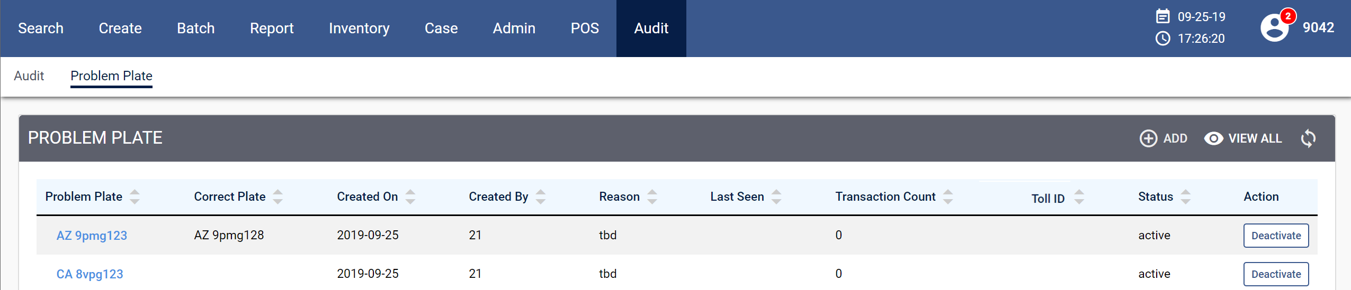
Opening image review screen
TPS image processing
Opening image review screen
Audit grid allows an authorized user to review the images in the queues.
Problem Plate lets an authorized user add, edit, or delete a problem plate.

Slide 9
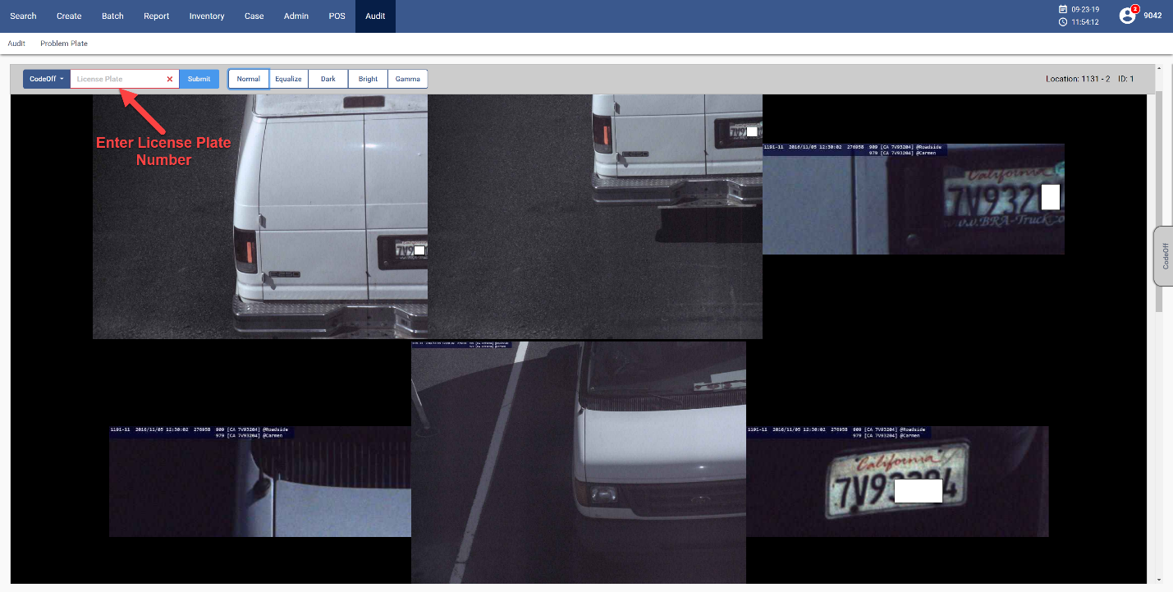
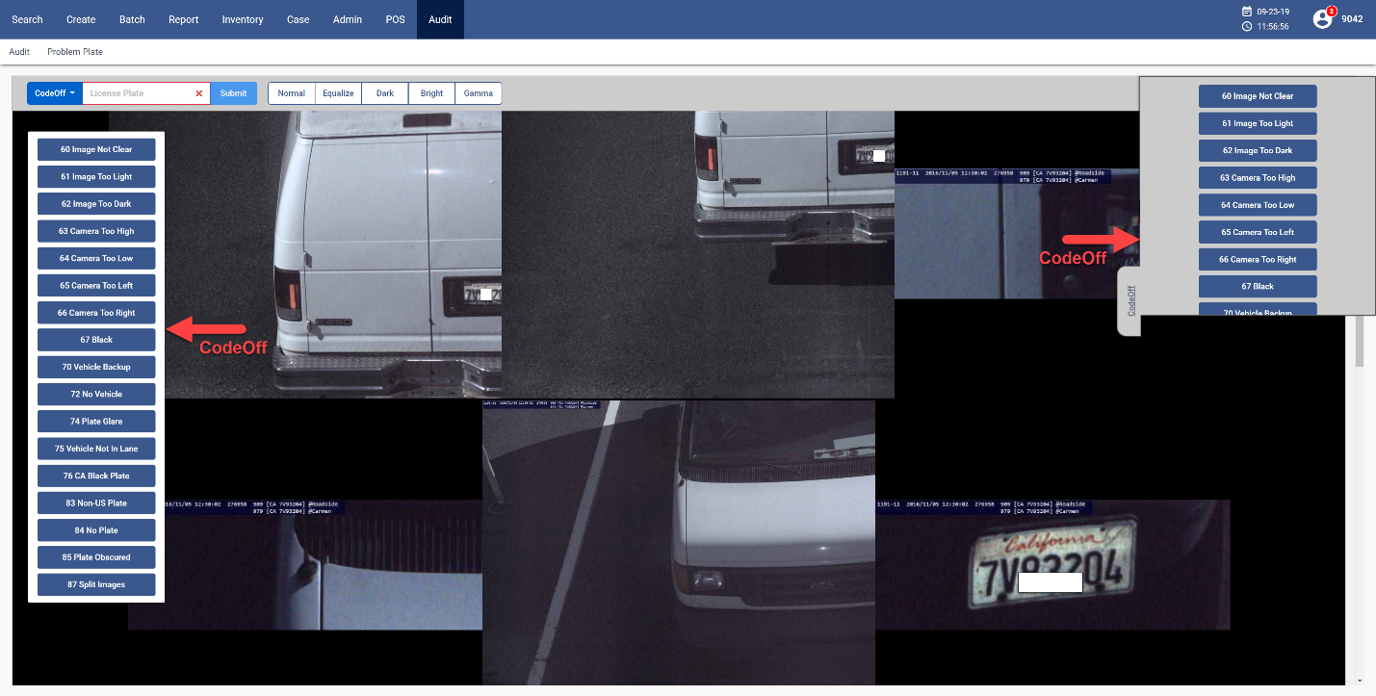
Image review
Tps image processing
Image review
After logging in, most users will click an option in the Queue to begin receiving images for review.
Enter the state and license plate number using the two-letter postal state code. If you don't enter a state code, the system will default to CA.
Press Enter to move to the next transaction.
Scroll down to see more images of the current transaction.
For an unreadable license plate image, enter a two-digit ‘code-off’ value to indicate the reason the plate could not be read and load the next images. (Coded off images may be reviewed by a supervisor for positive identification or for coaching purposes.)

Slide 10
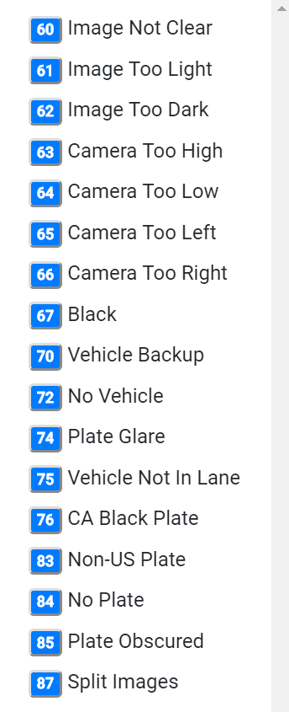
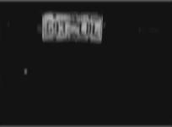


Code-off examples
Tps image processing
Code-off examples
Some unreadable images and their code-off values:
60 | Image Not Clear | The image is blurry due to vehicle or camera motion.
61 | Image Too Light | The overall image is too bright. Not enough contrast.
62 | Image Too Dark | The overall image is too dark. Not enough contrast.

Slide 11
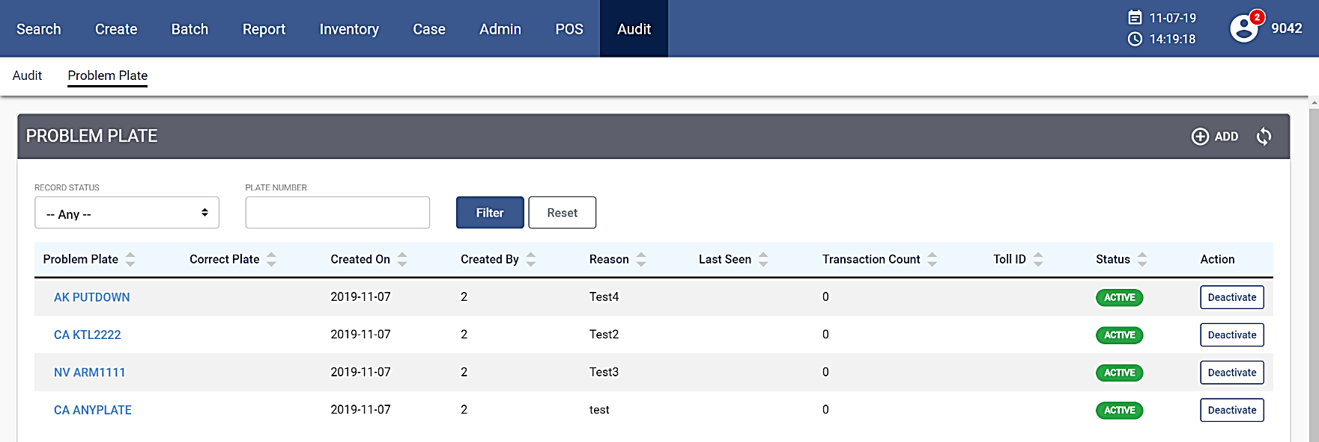
Problem plate
Tps image processing
Problem plate
The image reviewing application allows authorized users to add or delete license plates from the problem plate database. A “problem plate” is one which has been previously misread due to similarities between certain letters (E vs F, etc.) .
Plates with repeated customer disputes are also considered as problem plates.
If a transaction is sent to the application that has a plate in the problem plate database (based on automated or human review), the transaction will be queued for a third (supervisor-level) review before it is forwarded to the CSC System for posting.

Slide 12

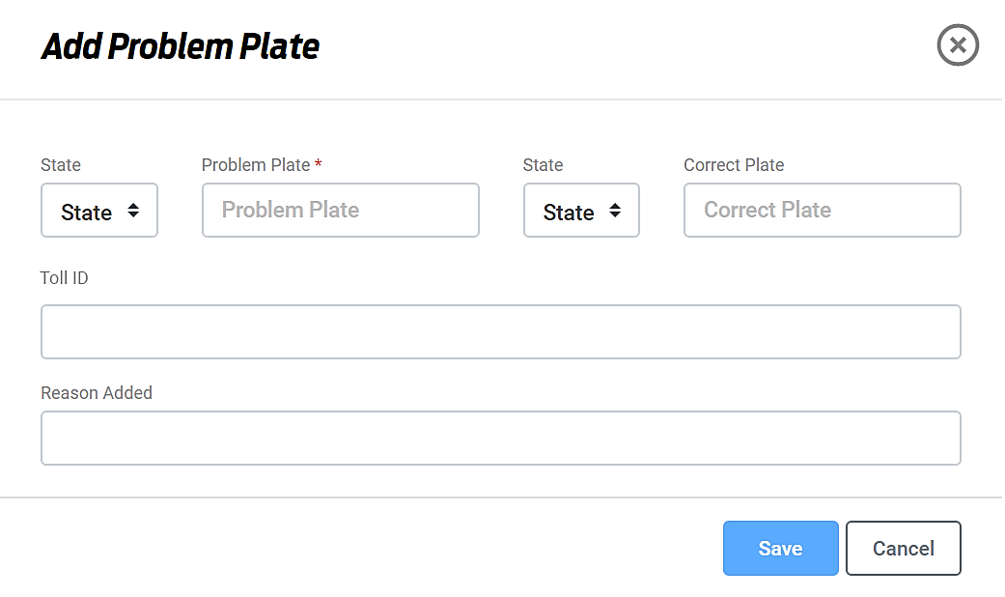
Problem plate – add a plate
Tps image processing
Problem plate – add a plate
To add a license plate to the Problem Plate database:
Click Audit in the Menu options. The Audit screen displays with Audit and Problem Plate links.
Click the Problem Plate link. The PROBLEM PLATE grid displays.
Click +ADD on the header of the Problem Plate grid. Add Problem Plate appears with problem plate data fields.
Select the state from the dropdown, enter the problem plate (required) number and the correct plate (optional) number in their respective fields.
Enter the related transaction number and add a reason in the Reason Added field and then click Save.
The problem plate is added to the Problem Plate database.

Slide 13
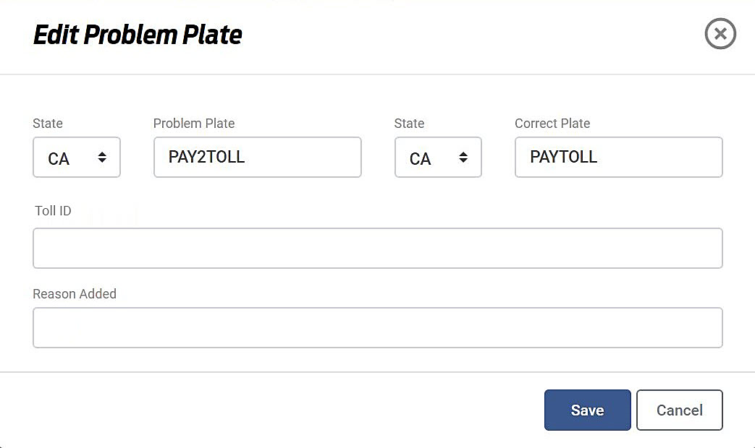
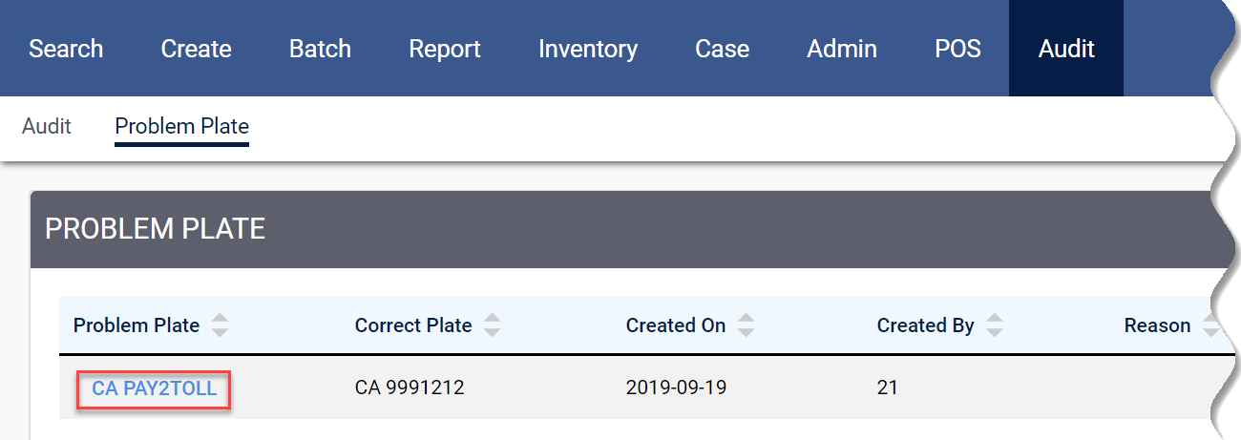
Problem plate – edit problem plate
Tps image processing
Problem plate – edit problem plate
To edit a problem plate:
From the Problem Plate grid, click on the problem plate link.
Edit Problem Plate dialog box displays.
Make necessary changes and then click Save. The Problem Plate grid now reflects your changes.

Slide 14
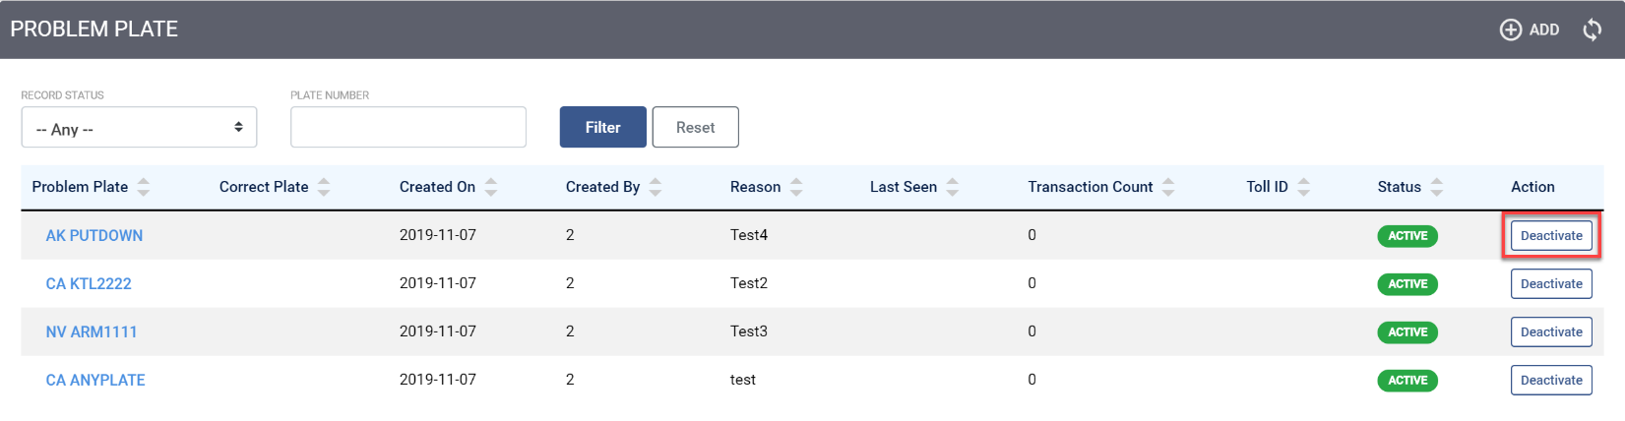
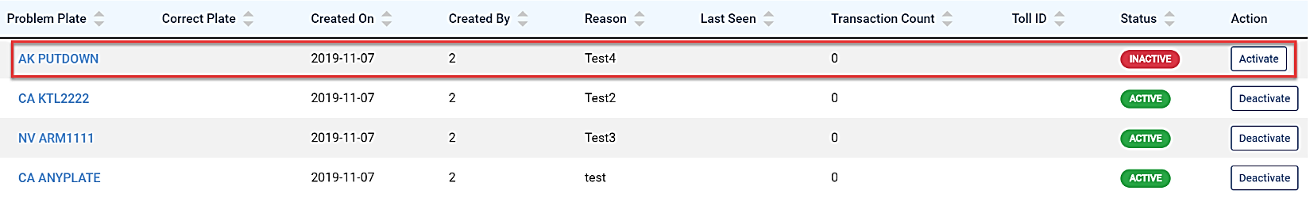
Problem plate – deactivate problem plate
Tps image processing
Problem plate – deactivate problem plate
To deactivate a license plate from the Problem Plate database:
From the Problem Plate grid, on the existing plate, click Deactivate under Action.
The problem plate record's status is updated in the grid as Inactive, in red.
To activate the deactivated plate, click Activate under Action.
The license plate status changes to Active and appears green.

Slide 15
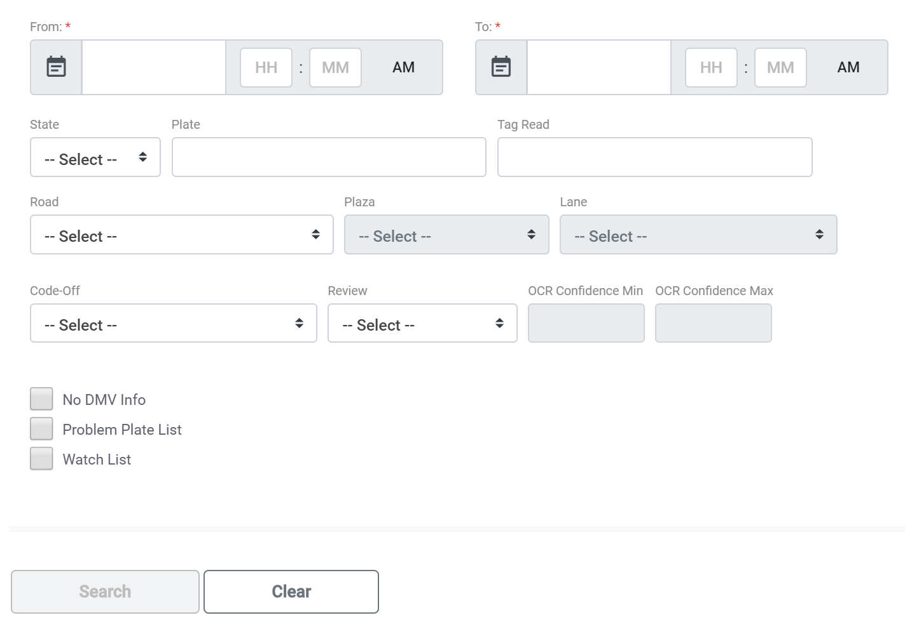
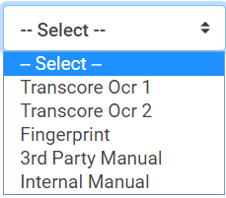
Road event review search
Tps image processing
Road event review search
The Road Event Review Search section details the image search process.
To perform a Road Event Review Search:
On the TPS Search screen, go to Audit> Reviews. Road Event Review Search screen displays.
Select the From/To dates of the transaction from the calendar.
Select the state from the dropdown, enter the license plate number, and choose Road, Plaza, and Lane.
Select a Code-Off value from the dropdown list.
Select an option from Review dropdown.

Slide 16
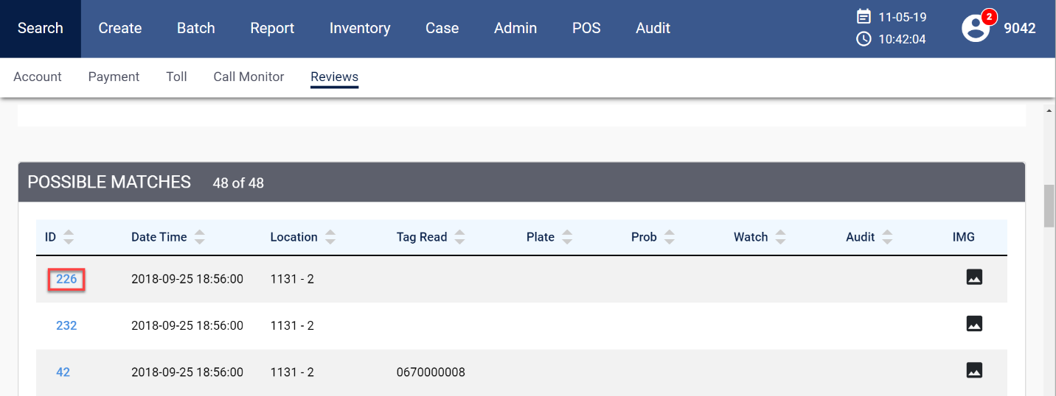
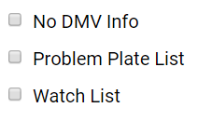
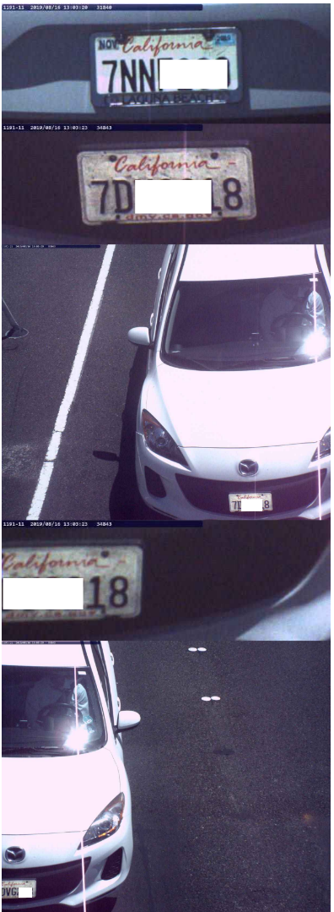

Road event review search cont’d
Tps image processing
Road event review search cont’d
Check one of the options:
Click Search. The system displays the search results in the POSSIBLE MATCHES table.
Click on the image icon on the right. A set of vehicle images shows up for that transaction.

Slide 17
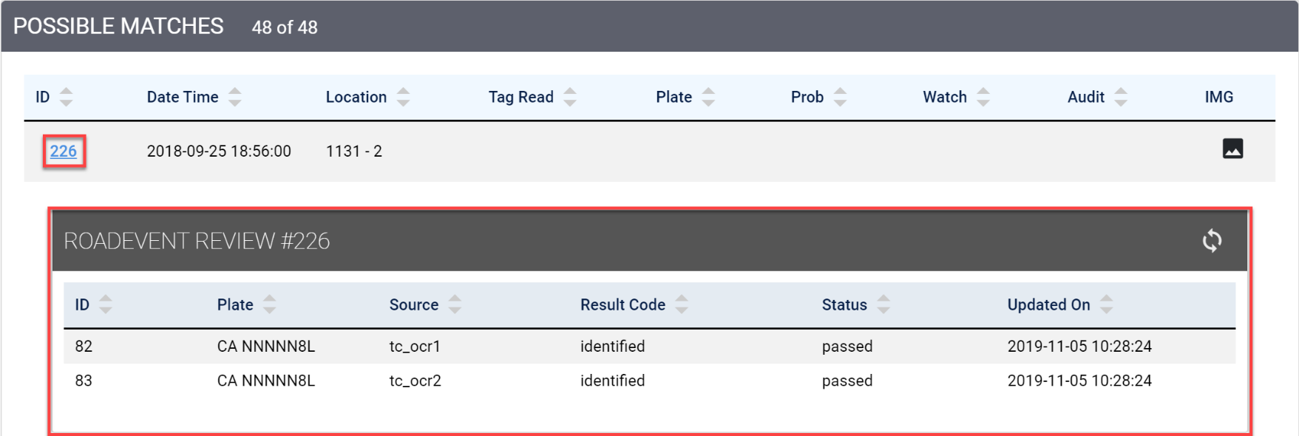
Road event review search cont’d
Tps image processing
Road event review search cont’d
Click on the Road Event ID to view the details. A separate grid within, details the specific road event. The details include road event review ID, plate number, transaction source, result code, status (pass/fail), and the date of updates.
Click on the same Road Event ID (such as #226 in the screenshot) to close the inside grid.

Slide 18
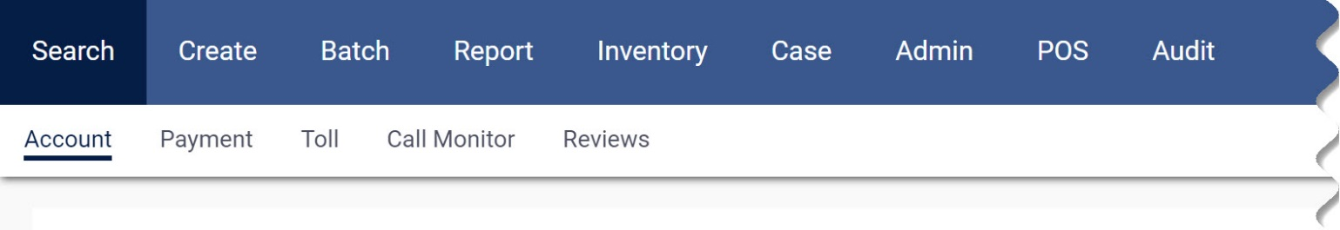
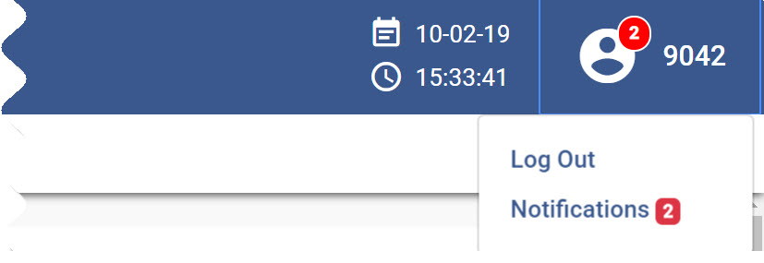
Logging out
Tps image processing
Logging out
To end your image review session:
In the TPS menu bar, click the headphone icon located in the top right corner and click Log Out. The system takes you back to the login screen.
To continue working in the TPS system, log in again.
To close the application, close the window.

Slide 19




Break
Break

Slide 20
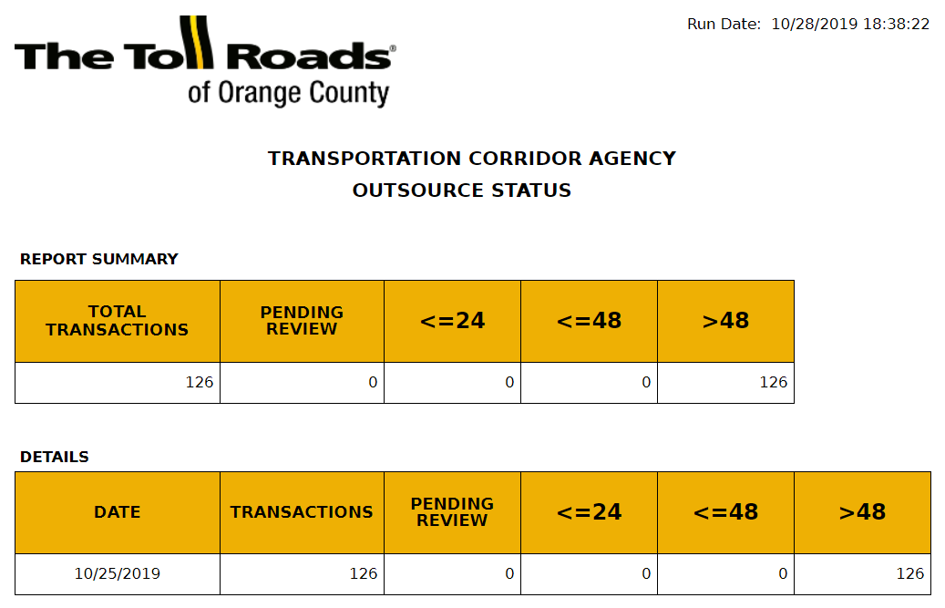
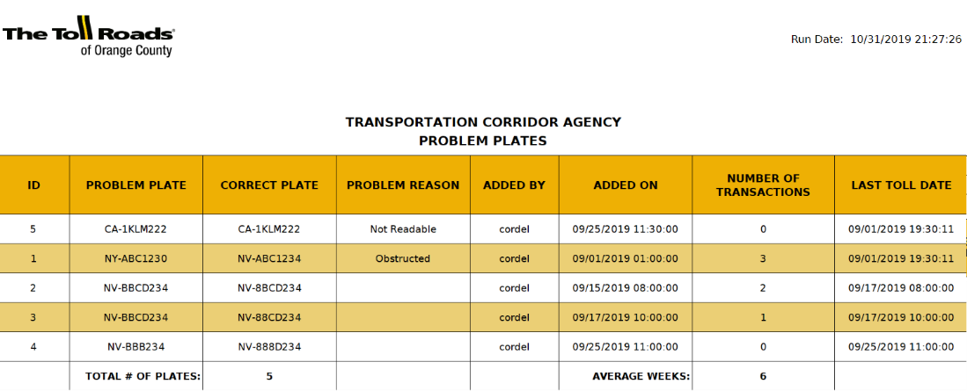
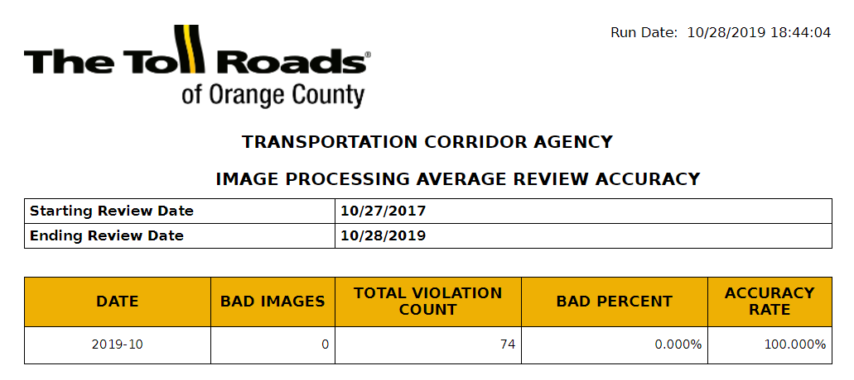
Reports
Tps image processing
reports
Time to Process
Image Review Detail
Audit Results
Problem Plates
Problem Plate History
Problem Plate Transactions
Time in Queue
User Productivity
IP Audit
Outsource Status
Image Processing Average Review Accuracy
Image Processing Days to Wait
Image Processing Status
TPS Image Processing Report allows authorized users to view and run these reports in the table.

Slide 21
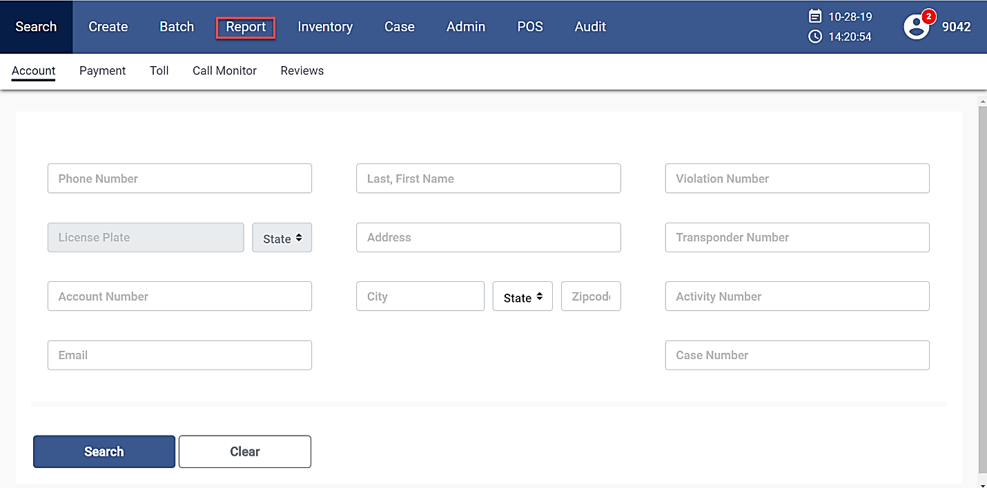
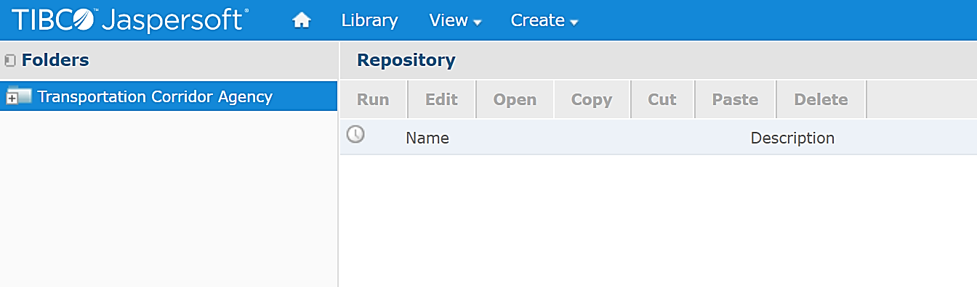
Browsing reports
Tps image processing
browsing reports
You can browse Image Processing reports by clicking the Report button on the TPS Search screen.
TIBCO Jaspersoft Report Repository displays with Folders on the left nav bar and Repository on the right pane.
The Repository shows you the available reports, based on your user configuration
Folders:
Reports are organized into categories and placed into folders
Repository:
Shows the reports available in the selected folder

Slide 22
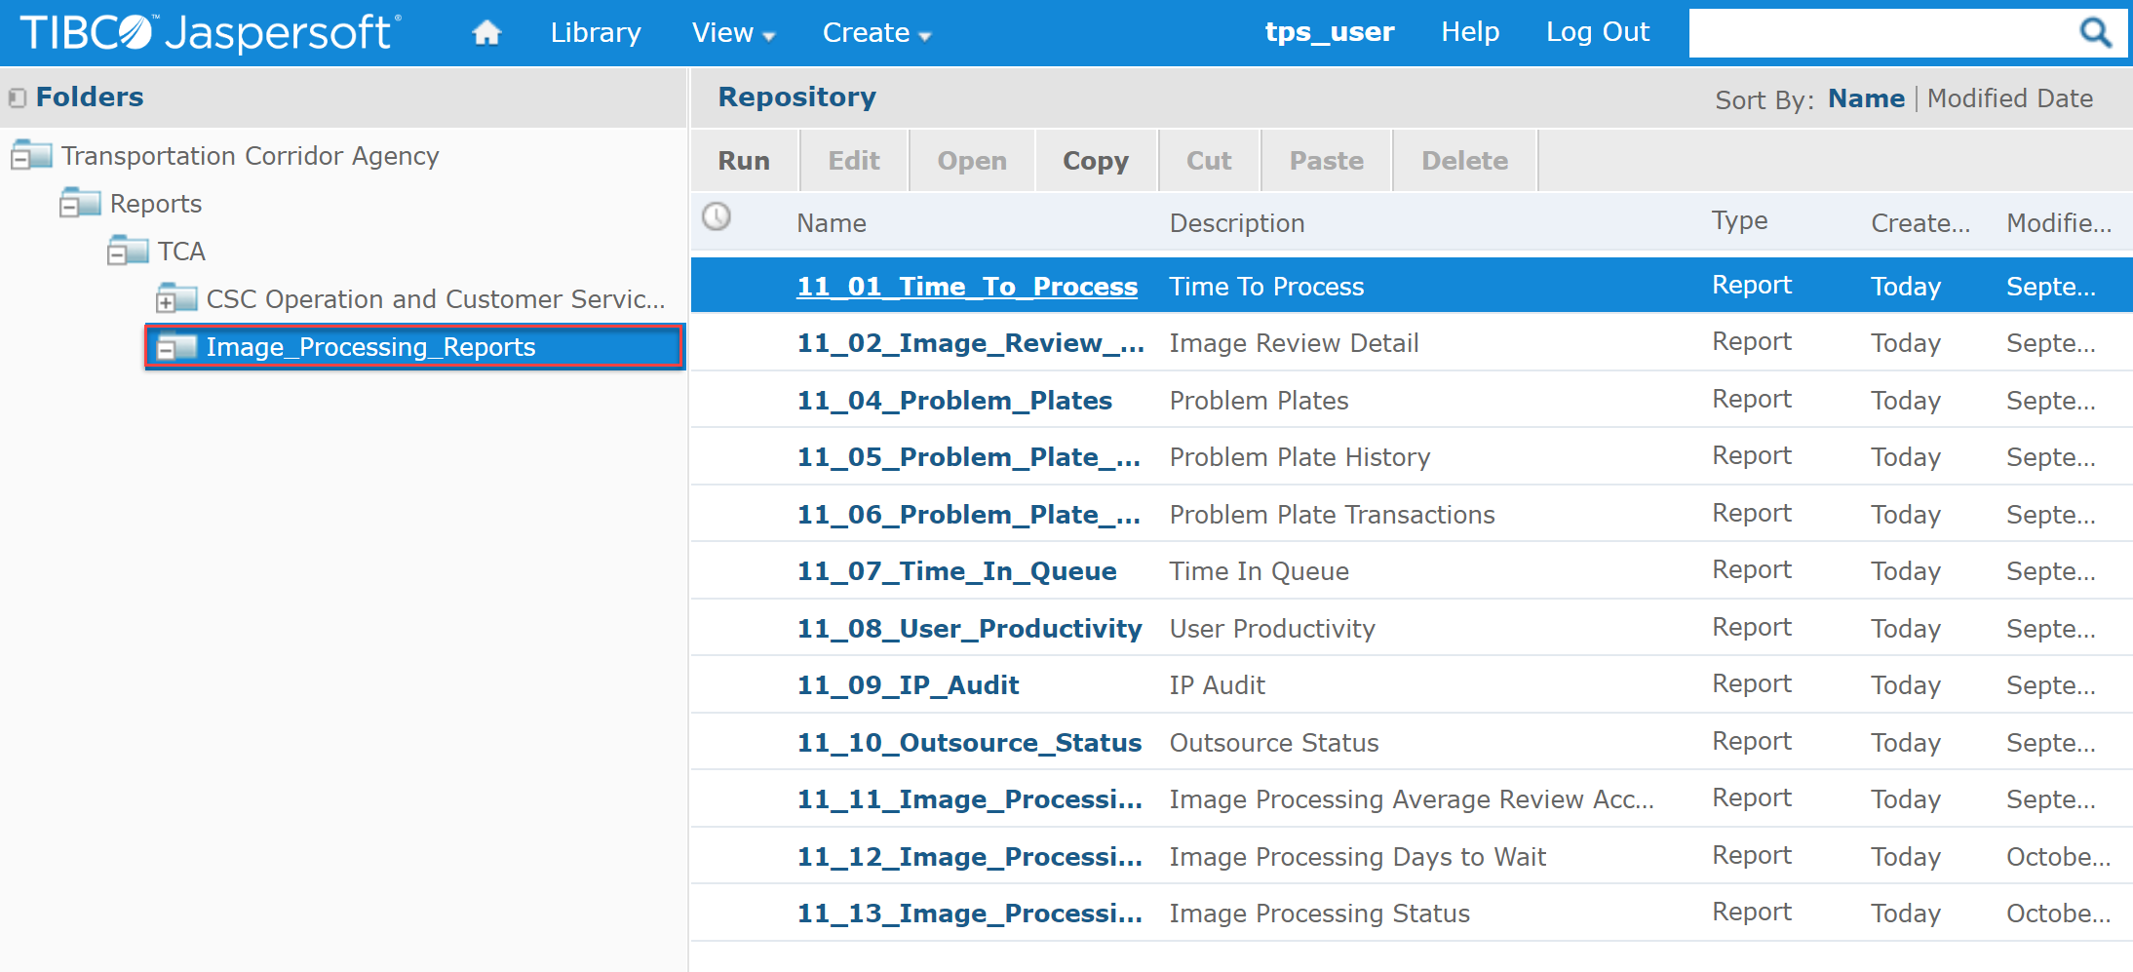
Browsing reports cont’d
Tps image processing
browsing reports cont’d
You can browse the existing reports by expanding Transportation Corridor Agency folder. In the example, Image Processing Reports is selected. The right pane displays the report list.
Click the link to run a report.

Slide 23
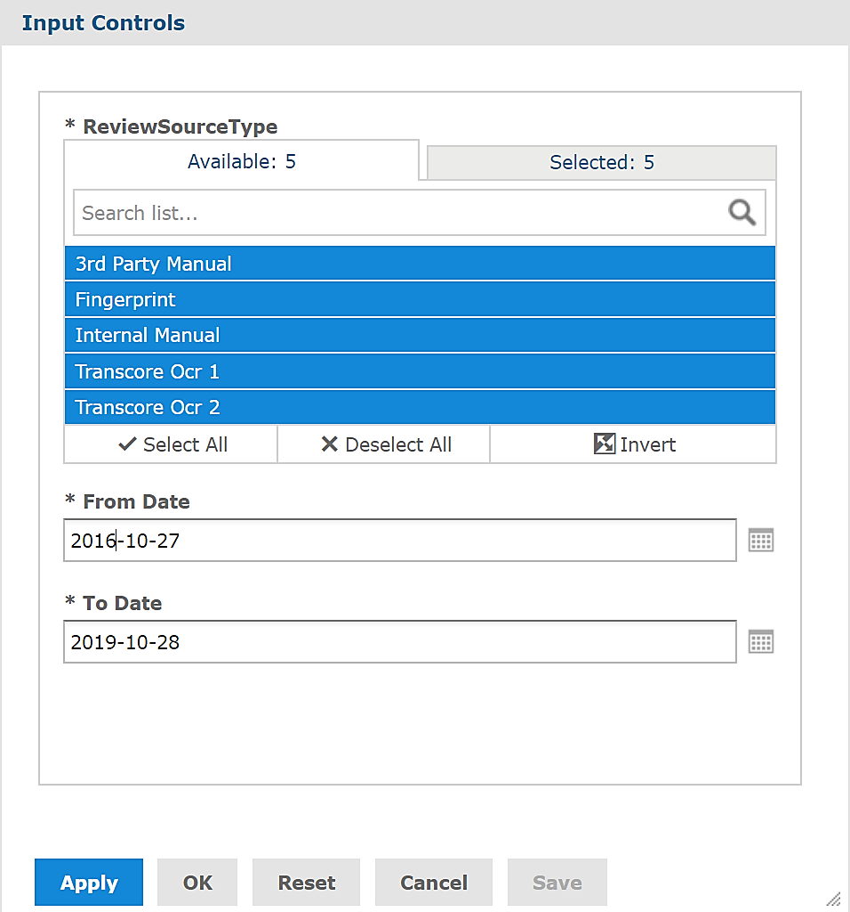
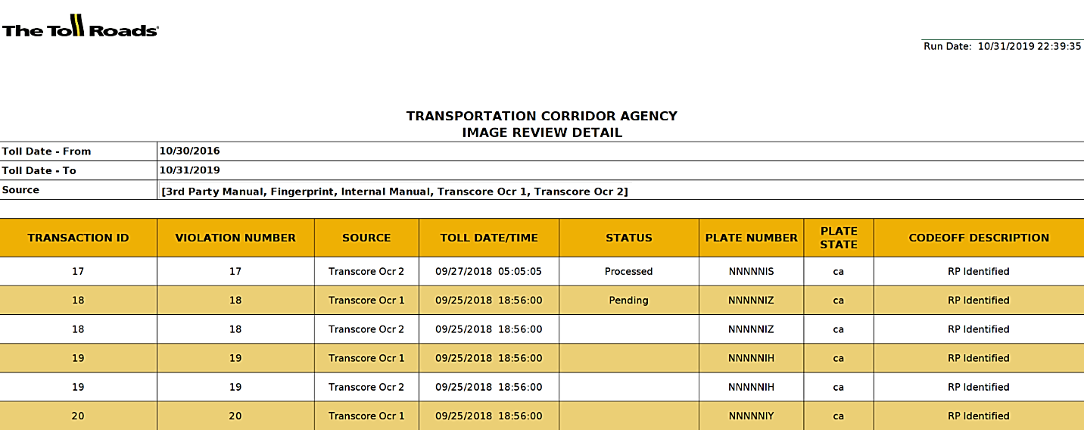
Running reports
Tps image processing
Running reports
When you click a link:
The report’s Input Controls are displayed for the report with filters in which case, you’ll enter the required input controls to run the report.
No input controls screen will be displayed for reports with no filters and Jasper will display a report instantaneously. (e.g., Problem Plates Report)
Running Reports with Filters
To run a report with filters:
Click the desired report link from the list.
Input Controls screen displays.
Enter the required filters and click OK.
Note: You may type in the desired dates or click the Calendar icon next to each date field to choose from the calendar.

Slide 24
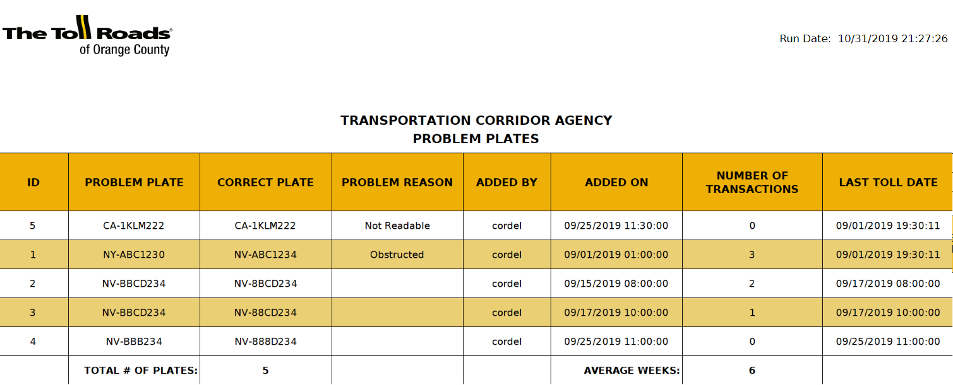
Running reports cont’d
Tps image processing
Running reports cont’d
Running Reports Without Filters
To run a report without filters:
Click the desired report link in the list. The requested report is generated instantaneously.
The following is a sample report that didn’t have any filters.

Slide 25

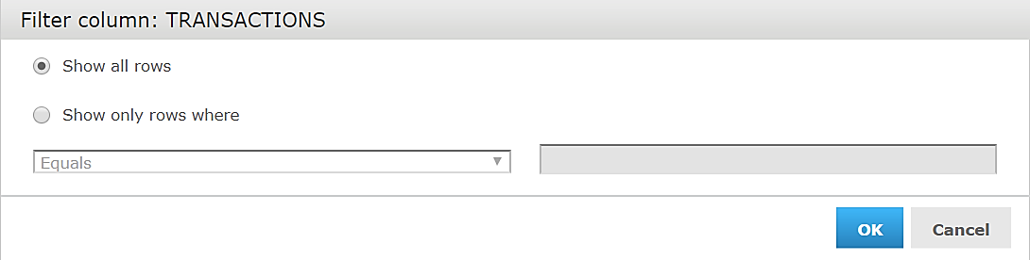
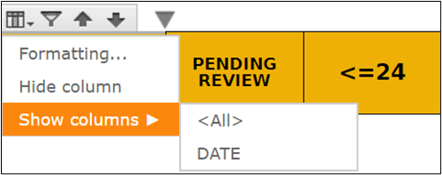
Sorting table data
Tps image processing
Sorting table data
Sorting Functionality
When you view a table, you can click a column heading to sort the data.
Click on a column of the report you’re on. Sorting functionality displays above the column.
Use Up and Down arrows to sort the table data in ascending or descending order.
Click the funnel-shaped icon to open Filter Column dialog box specific to column content.
If desired, filter a column data by engaging various parameters available in the box.
Formatting Column option lets you hide an entire column. By clicking the same icon, you can make the invisible column visible again, or choose the name (e.g. ‘Date’ in this example) of the column to bring it back.
Filter Column
Format Column

Slide 26
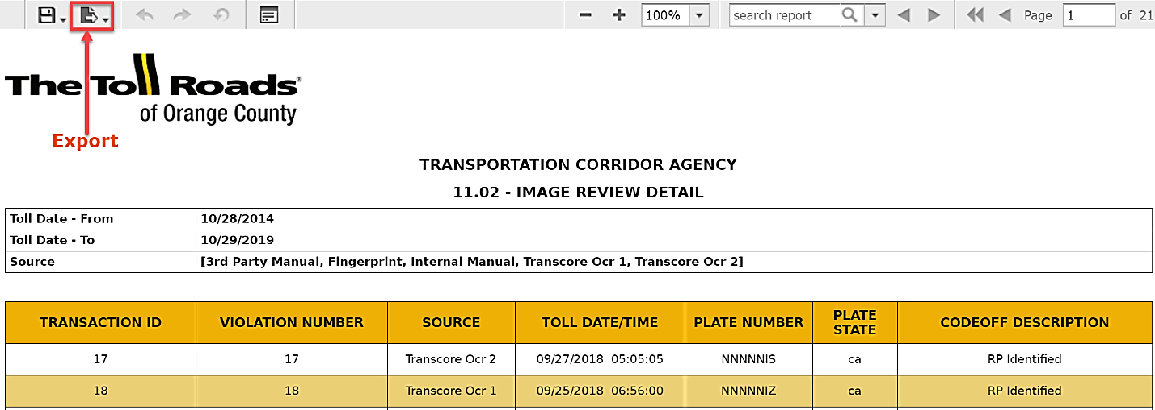
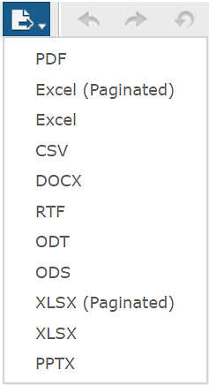
Exporting, emailing, printing reports
Tps image processing
Exporting, emailing, printing reports
When the report displays the desired information on screen, you can export it in a variety of formats such as Microsoft Word, Microsoft Excel, Adobe PDF, and other useful formats.
To export a report in your desired format:
Click the Export button on the top left side of the Jasper toolbar.
Choose the desired format from the list.
The report opens in the chosen format.
Save it to a location on your computer for later viewing, printing, or sharing.

Slide 27
Questions and Answers
Q
Questions
A
And Answers
&

Slide 28
Quizzes
Tps Image processing
quizzes
Quiz time

Slide 29
Question 1
Tps image processing
Question 1
If you can’t read an image, you should
(Select all that apply)
Enter all the characters you can read, leaving out the ones you can’t
Report it to a supervisor
Enter the make and model of vehicle
Code it off by entering a reason code to indicate what was wrong with the image
Try to enhance the image to make it more readable

Slide 30
Answer 1
Tps image processing
answer 1
If you can’t read an image, you should:
(Select all that apply)
Enter all the characters you can read, leaving out the ones you can’t
Report it to a supervisor
Enter the make and model of vehicle
Code it off by entering a reason code to indicate what was wrong with the image
Try to enhance the image to make it more readable

Slide 31
Question 2
Tps image processing
question 2
A ‘problem plate’ is
A license plate added to a special list that always requires human review
A license plate that has an unusual configuration of letters and numbers
A license plate which has been previously misread due to similarities between certain letters such as ‘E’ and ‘F’
A plate belonging to a motorist with many complaints

Slide 32
Answer 2
Tps image processing
answer 2
A ‘problem plate’ is
A license plate added to a special list that always requires human review
A license plate that has an unusual configuration of letters and numbers
A license plate which has been previously misread due to similarities between certain letters such as ‘E’ and ‘F’
A plate belonging to a motorist with numerous complaints

Slide 33
Question 3
Tps image processing
question 3
Double-blind review’ means
The same image is reviewed by two reviewers without the knowledge of one another
No one can see an image more than once
Images are assigned to transactions without human review
All of the above

Slide 34
Answer 3
Tps image processing
answer 3
‘Double-blind review’ means
The same image is reviewed by two reviewers without the knowledge of one another
No one can see an image more than once
Images are assigned to transactions without human review
All of the above

Slide 35
Question 4
Tps image processing
Question 4
Audit Reviews are (Select all that apply)
A tool to verify accuracy of the image review process
Never performed on machine-read transactions
Used to correct mistakes made by other reviewers
Performed on a configurable percentage of transactions
Used to reconcile revenue collected from image-based transactions
All of the above

Slide 36
Answer 4
image processing
answer 4
Audit Reviews are (Select all that apply)
A tool to verify accuracy of the image review process
Never performed on machine-read transactions
Used to correct mistakes made by other reviewers
Performed on a configurable percentage of transactions
Used to reconcile revenue collected from image-based transactions
All of the above

Slide 37
Question 5
Tps image processing
question 5
A ‘Road Event’ is
An accident or breakdown that closes a toll location
A single passage of a vehicle through a toll location
A charity motorcycle ride that reimburses toll charges to the participants
Taking a road trip to Palm Springs

Slide 38
Answer 5
Tps image processing
answer 5
A ‘Road Event’ is
An accident or breakdown that closes a toll location
A single passage of a vehicle through a toll location
A charity motorcycle ride that reimburses toll charges to the participants
Taking a road trip to Palm Springs

Slide 39
Question 6
Tps image processing
question 6
Fingerprint Reviews mean
Reviews of fingerprints taken at a police station
Images sent to VSR (Vehicle Signature Recognition) application for identification by a non-OCR engine.
These are final reviews and can’t be altered
None of the above

Slide 40
Answer 6
Tps image processing
answer 6
Fingerprint Reviews mean
Reviews of fingerprints taken at a police station
Images sent to VSR (Vehicle Signature Recognition) application for identification by a non-OCR engine.
These are final reviews and can’t be altered
None of the above

Slide 41
Question 7
Tps image processing
question 7
Manual Reviews are
A process where an Image Processing personnel views the images and enters a license plate number or code-off value.
Used to correct mistakes made by other image reviewers
The reviews performed unlimited number of times
The reviews that can determine who has the largest outstanding violation balance

Slide 42
Answer 7
Tps image processing
answer 7
Manual Reviews are
A process where an Image Processing personnel views the images and enters a license plate number or code-off value.
Used to correct mistakes made by other image reviewers
The reviews performed unlimited number of times
The reviews that can determine who has the largest outstanding violation balance

Slide 43
Question 8
Tps image processing
question 8
Imaging reports can answer these questions:
(Select all that apply)
How many vehicles were photographed on a particular day
How many images a reviewer processed in a week
Who has the largest outstanding violation balance
The number of violations referred for court processing
None of the above

Slide 44
Answer 8
Tps image processing
answer 8
Imaging reports can answer these questions:
(Select all that apply)
How many vehicles were photographed on a particular day
How many images a reviewer processed in a week
Who has the largest outstanding violation balance
The number of violations referred for court processing
None of the above

Slide 45
Question 9
Tps image processing
question 9
A Level 3 Review means
(Select all that apply)
The previous reviews were badly done
The vehicle is on the Problem Plate list
The previous reviews did not agree, and the third review has to choose one of the previous reviews as the final result
The previous reviews did not agree, and this review will be accepted as the final result whether or not it agrees with either of the previous reviews

Slide 46
Answer 9
Tps image processing
answer 9
A Level 3 Review means
(Select all that apply)
The previous reviews were badly done
The vehicle is on the Problem Plate list
The previous reviews did not agree, and the third review has to choose one of the previous reviews as the final result
The previous reviews did not agree, and this review will be accepted as the final result whether or not it agrees with either of the previous reviews

Slide 47
Question 10
Tps image processing
question 10
An Image Reviewer should
(Select all that apply)
Review plates as fast as possible; checks and balances with other reviews will ensure accuracy
Not leave any plate unidentified; ask a neighbor or supervisor for help if a plate number is not certain
Try to never code off an image; code-offs are lost revenue the agency cannot afford
Strike a balance between speed, accuracy, and determination; try to get as many plates as possible, but quickly decide to skip or code off an unreadable image and move on

Slide 48
Answer 10
Tps image processing
answer 10
An Image Reviewer should
(Select all that apply)
Review plates as fast as possible; checks and balances with other reviews will ensure accuracy
Not leave any plate unidentified; ask a neighbor or supervisor for help if a plate number is not certain
Try to never code off an image; code-offs are lost revenue the agency cannot afford
Strike a balance between speed, accuracy, and determination; try to get as many plates as possible, but quickly decide to skip or code off an unreadable image and move on

Slide 49
Thank you
Thank You!

